Slide 1

Applied AI Investing
Find, Show & Share AI Based Investment Algorithms to Maximize Portfolio Performance

Slide 2
Problem
Retail traders lack access to affordable, transparent AI-driven trading tools.
Algorithm marketplaces today are either opaque, expensive, or lack community validation.

Slide 3
Solution
Applied AI Investing democratizes algorithmic trading with a Bring Your Own Algorithm (BYOA) model
Community-driven marketplace with transparent performance tracking and fair revenue sharing

Slide 4
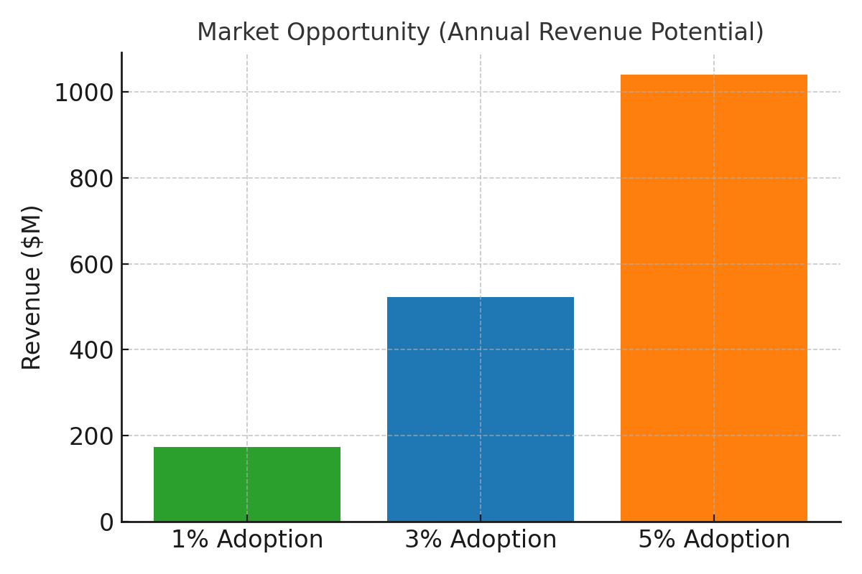
Market Opportunity

Slide 5
Barrier to Entry (Moat)
Proprietary Algorithm Database grows over time
Community validation builds trust and credibility
Brand reputation and broker / data integrations reinforce defensibility

Slide 6
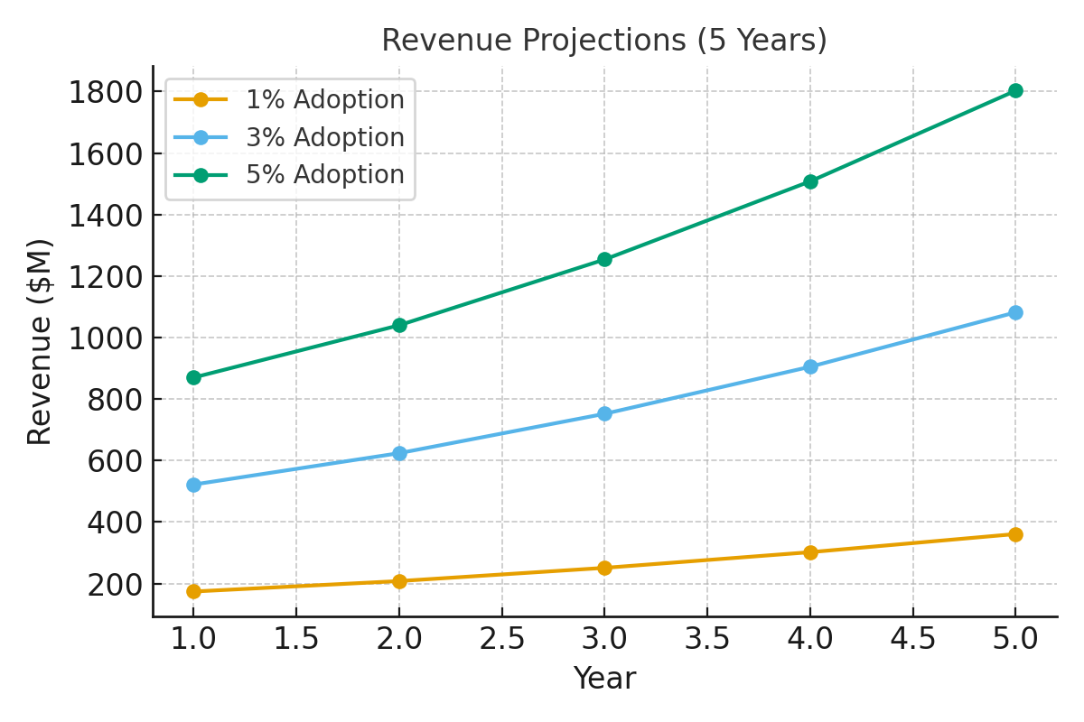
Revenue Projections

Slide 7
Team and Ask
Experienced leadership team with 30+ years of experience in investing and tech expertise
Founders of over eight venture funded startup companies from the ground up
Founders of Clearstation – a retail trading performance platform acquired by E-Trade
Seeking strategic capital and partnership to accelerate user adoption

Slide 8
Summary
Problem
Retail traders lack access to affordable, transparent AI-driven trading tools.
Algo marketplaces today are either opaque, expensive, or lack community validation.
Solution
Applied AI Investing democratizes algorithmic trading with a BYOA (Bring Your Own Algo) model.
Community-driven marketplace with transparent performance tracking and fair revenue sharing.
Moat
Proprietary algo database grows over time.
Community validation builds trust and credibility.
Brand reputation and broker/data integrations reinforce defensibility.
Revenue Potential
1% adoption of U.S. retail traders = ~$174M annual revenue.
3% adoption = ~$522M annual revenue; 5% adoption could exceed $1B.
Scalable revenue streams: subscriptions, revenue sharing, premium analytics, institutional licensing.

Slide 9
Corporate Values
We are impeccable with our word
We don’t take anything personally
We don’t make assumptions
We always do our best
We have fun in service of our customers

